Slide 1
Basis Data Klien Server Pertemuan – 2
Andika Sundawijaya

Slide 2
Android
WHAT IS ANDROID?
A Software platform and operating system for mobile.
Based on the Linux kernel.
Android was found way back in 2003.
It was developed in Palo Alto, California.
Android was developed by the Andy Rubin, Rich Miner, Nick Sears and Chris White.

Slide 3
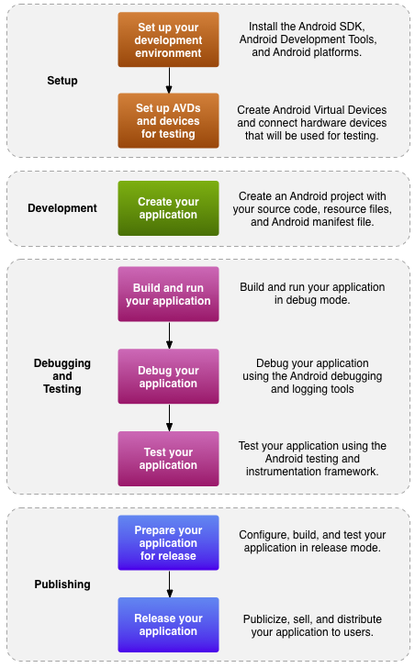
Development process for an Android app

Slide 4





Setup - Tools

Slide 5
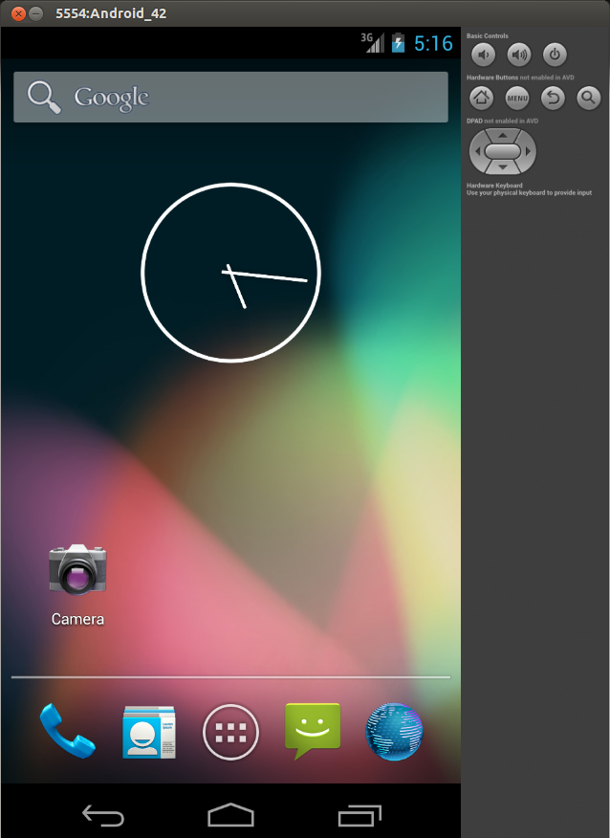
Set up AVD and Devices

Slide 6
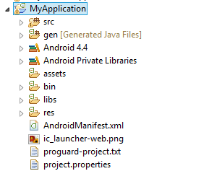
Project Structure
App behavior in Java
Binary Assets
Resource and XML layouts
Configuration Files

Slide 7
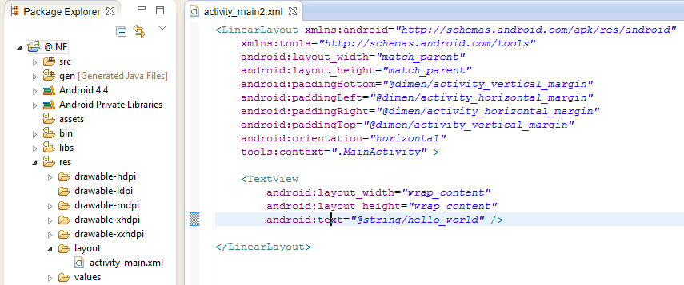
Layout in Android
An XML‐based layout is a specification of the various UI components (widgets) and the relationships to each other –and to their containers –all written in XML format.
res/layout

Slide 8
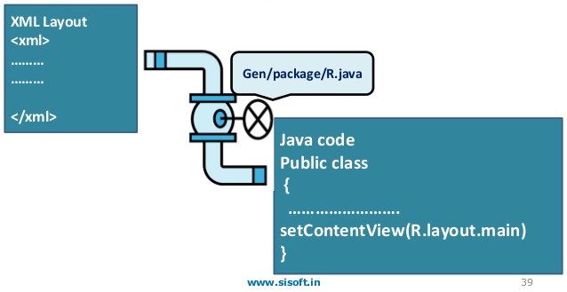
Attaching Layouts to Java Code → XML to Java
public class Main extends Activity {
protected void onCreate(Bundle savedInstanceState) {
super.onCreate(savedInstanceState);
setContentView(R.layout.main);
}
}

Slide 9
Attaching Layouts to Java Code - 2
Main.java
public class Main extends Activity {
protected void onCreate(Bundle savedInstanceState) {
super.onCreate(savedInstanceState);
setContentView(R.layout.main);
}
}
R.java
public static final class layout {
public static final int main=0x7f030000;
}

Slide 10
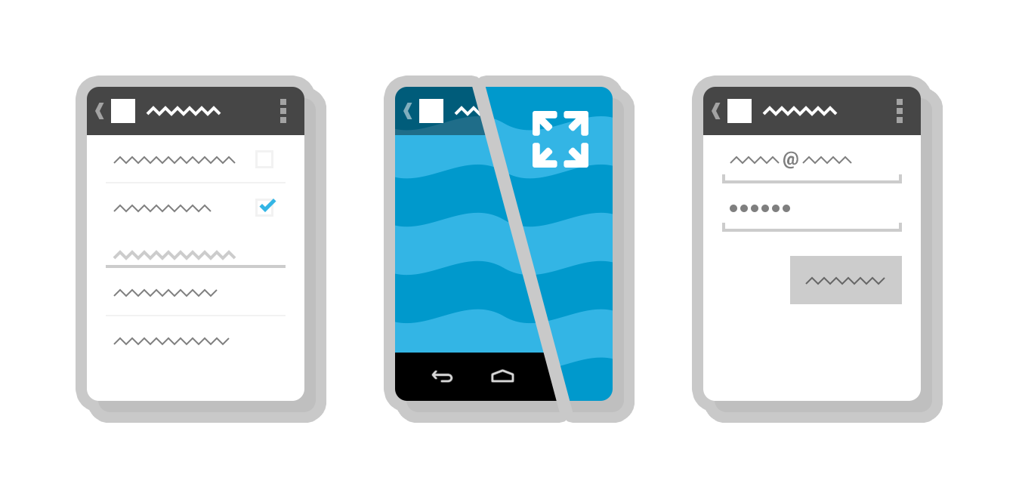
App behavior in Java
An Activity is an application component that provides a screen with which users can interact in order to do something, such as dial the phone, take a photo, send an email, or view a map.
Activity
Each activity is given a window in which to draw its user interface in xml layout.

Slide 11
Variable in Layout → XML to XML
Main.xml
<TextView
android:id="@+id/TextView1"
android:layout_width="wrap_content"
android:layout_height="wrap_content"
android:text="@string/hello_world“
/>
Strings.xml
<resources>
<string name="app_name">AKDip</string>
<string name="action_settings">Settings</string>
<string name="hello_world">Hello world!</string>
</resources>

Slide 12
Variable in Activity from Layout → XML to Java (Ex. TextView)
Main.java
protected void onCreate(Bundle savedInstanceState) {
super.onCreate(savedInstanceState);
setContentView(R.layout.activity_main);
TextView tv = (TextView) findViewById(R.id.TextView1);
tv.setText("Hello new World");
}
R.java
public static final class id {
public static final int TextView1=0x7f080003;
}

Slide 13
Variable in Activity from Layout → XML to Java (Ex. Button)
Main.xml
<Button
android:id="@+id/button1"
android:layout_width="wrap_content"
android:layout_height="wrap_content"
android:text="@string/tombol“
android:onClick=“saatTombolDitekan”
/>
Main.java
public void saatTombolDitekan(View v) {
Button bt = (Button) findViewById(R.id.button1);
bt.setText("Hello new World");
}

Slide 14
Check Point
Notes:
1. Apa yang biasanya dilakukan pada method onCreate()?
2. Bagaimana mekanisme layout dapat ditampilkan pada activity?
3. Bagaimana mekanisme sebuah component dapat berinteraksi dengan user?

Slide 15
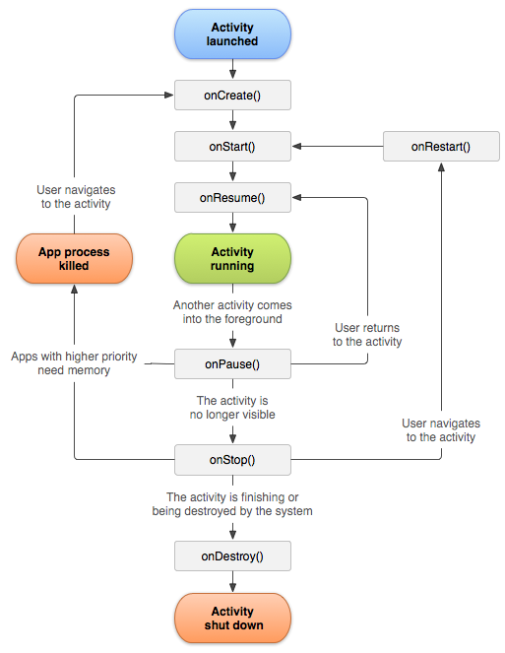
Android Activity Lifecycle

Slide 16
onCreate() → Called when the activity is first created. This is where you should do all of your normal static set up create views, bind data to lists, and so on.
onStart() → Called just before the activity becomes visible to the user.
onRestart() → Called after the activity has been stopped, just prior to it being started again.
onResume() → Called just before the activity starts interacting with the user.
onPause() → Called when the system is about to start resuming another activity.
onStop() → Called when the activity is no longer visible to the user.
onDestroy() → Called before the activity is destroyed.
Source : http://developer.android.com/guide/components/activities.html

Slide 17
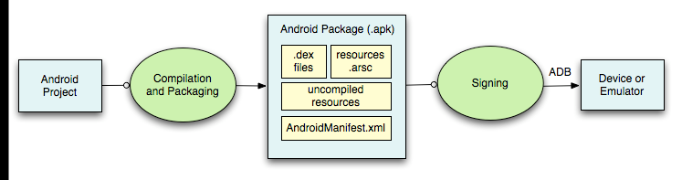
Debug and Testing
ADB is a client server program that connects clients on developer machine to devices/emulators to facilitate development.
An IDE like Eclipse handles this entire process for you.

Slide 18
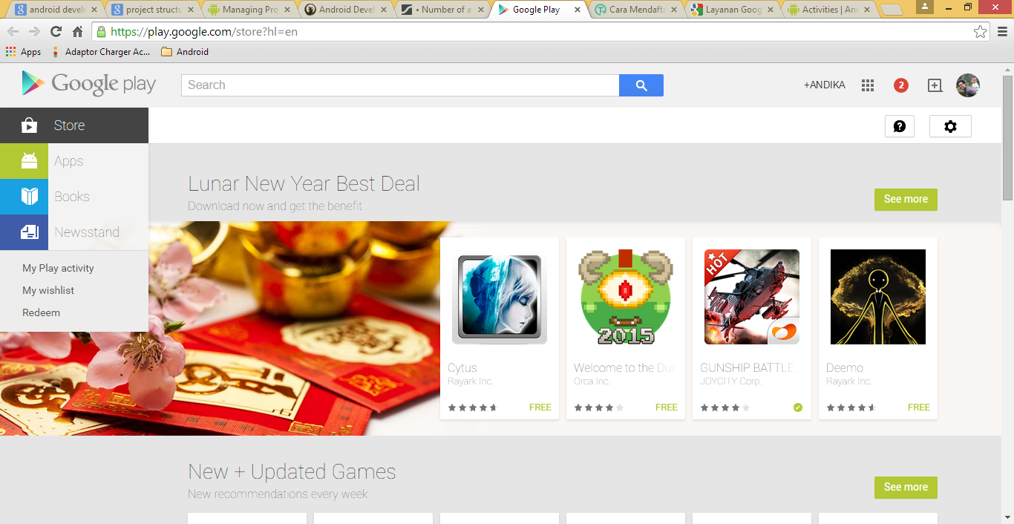
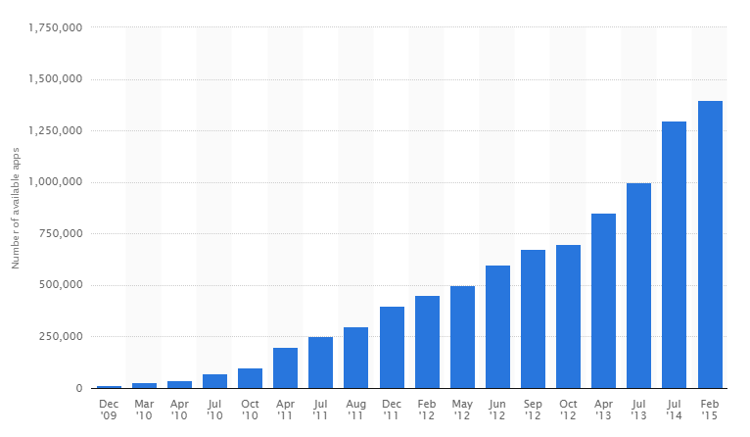
Publishing
1,4 million apps
Source : http://www.statista.com/statistics/266210/number-of-available-applications-in-the-google-play-store/

Slide 19
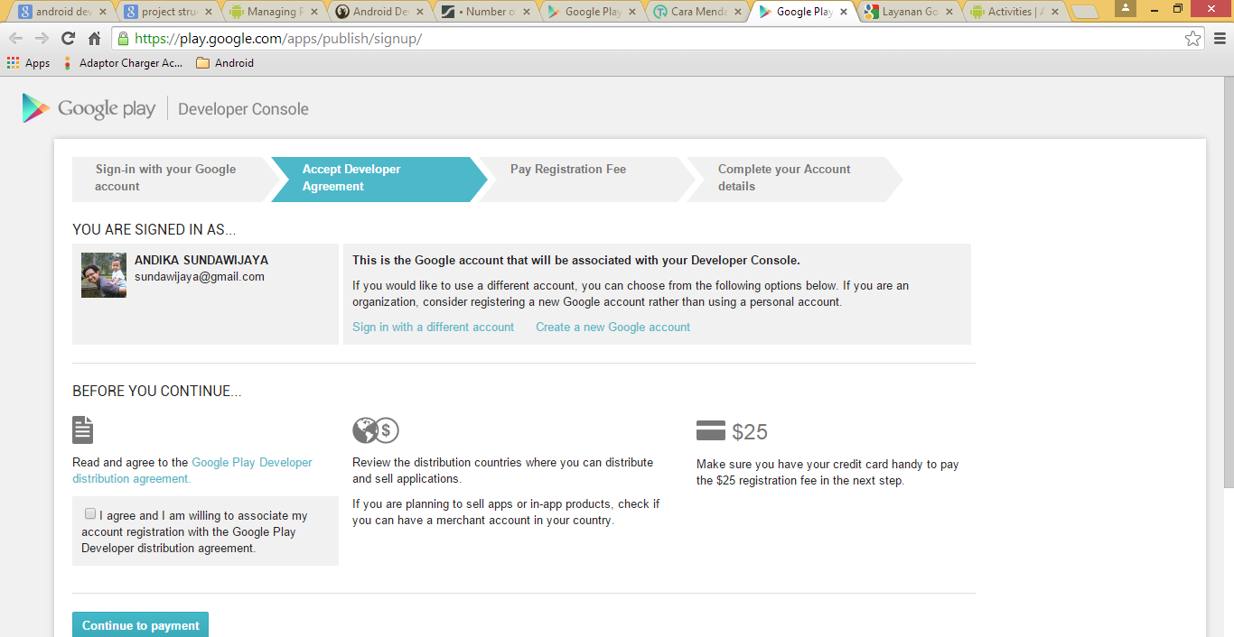
Registration on Google Play
play.google.com/apps/publish

Slide 20
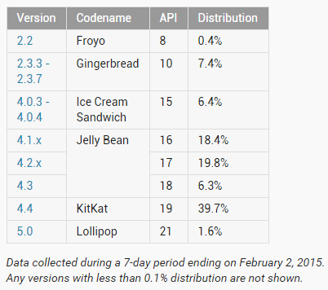
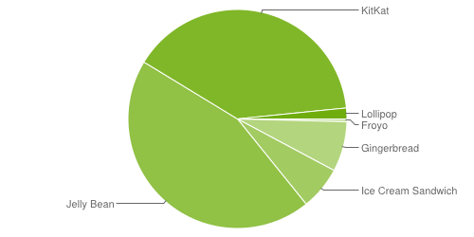
Distribution of Devices

Slide 21
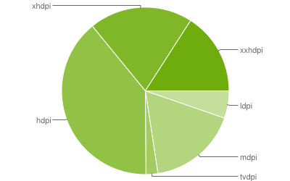

Slide 22
Thank you
Andika Sundawijaya
sundawijaya@gmail.com

